Slide 1
Library management system

Slide 2
ACKNOWLEDGEMENT
At the outset, we would like to express our sincere gratitude to our college, for providing us with such an opportunity to showcase our skills, our teacher for his guidance, and to each and every one who contributed to make this project a reality. Above all, we would like to thank God, the Almighty for giving us the strength and endurance to undertake this project and execute it to the best of our abilities.

Slide 3
Library Management System
This project work is a part of the Object Oriented Programming in C++, submitted to the department of Computer Science and Engineering.
As the name suggests, our project is basically a library management system that facilitates the user(a librarian) to add or delete the books from the system. It also helps to issue books or to show the booklist and much more.

Slide 4
Why libraries should use a library management system?
Increase efficiency: Our project enhances the efficiency of both librarians and library member.
Reduces cost: You can easily eliminate the no of employees thereby reducing the cost.
Saves time: A librarian can easily go through the history of individual library users without wasting time.
Increases the productivity of library workers: Library automation will increase the productivity.

Slide 5
THE SOURCE CODE
The program is created using C++ programming language & concepts of OOPs.
It consists of 8 header files namely iostream, fstream, bits/stdc++.h, stdlib.h, conio.h, ios, limits and iomanip.
It is divided into 7 different functions which when put together, serve as the library management system.
The program contains 2 classes (student and book) which are a major feature of OOPS.

Slide 6
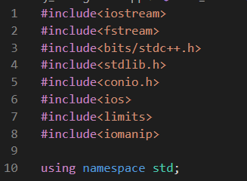
Header Files used in Program

Slide 7
Uses of various Header Files
iostream: It is used as a stream of input and output using cin and cout objects.
iomanip: It is used to access set() and setprecision() function to limit the decimal places in variables.
fstream: It is used to control the data to read from a file as an input and write into the file as an output.
limits: It determines various properties of the various variable types.
bits/stdc++: It contains all standard library of the standard header files.
stdlib: This header file contains the information of memory allocation / freeing functions.
conio: It contains the functions of console input and output.

Slide 8
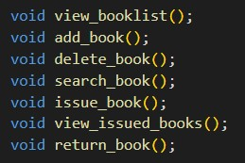
VARIOUS FUNCTIONS USED:

Slide 9
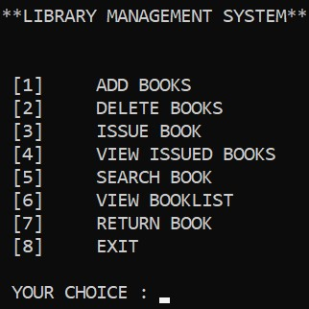
int main()
main() function is the driver function of this program.
The return type of this function is of int.
First of all, this function is executed. It prints various choices on the screen.
Then it asks for our choice in integer type. When the librarian enters the choice, the function corresponding to it is executed.
Switch case statements are used to execute functions corresponding to our choice no.

Slide 10
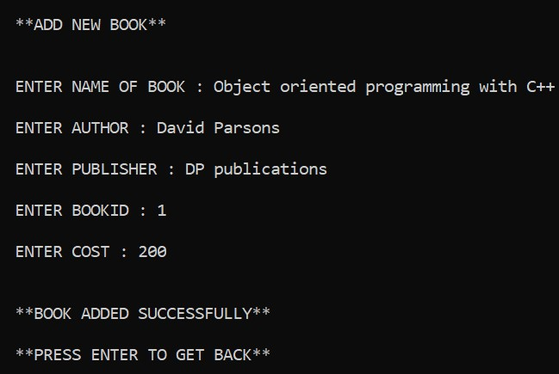
void add_book()
This function is created to add new books in the database of library.
It takes inputs of name, author, publisher, cost and book-id of the book through input() function declared in class - book.
Input() function is specifically created to take input of book details of the book to be added. It uses normal cin and cout functions to do so.
Then, a file named Bookdata.txt is opened, book data i written into it and the file is closed thereafter.

Slide 11
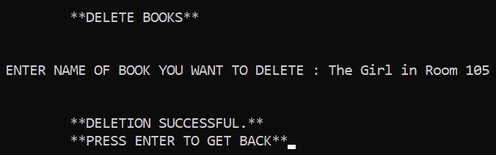
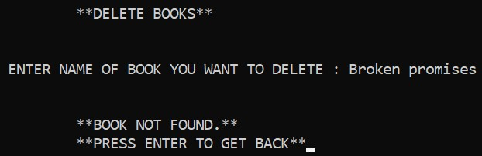
void delete_book()
This function is specifically created to delete any book from the database of library.
First of all, it takes input from the librarian as to which book they want to delete.
That book is temporarily stored in a file “Temporary.txt”.
Now it is checked whether the entered book name matches any book name in the file “Bookdata.txt”.
If the name matches, all the copies of that book are deleted.
If not, then a message is printed on the console. The printed message is, “BOOK NOT FOUND”.
Successful deletion
Unsuccessful deletion

Slide 12
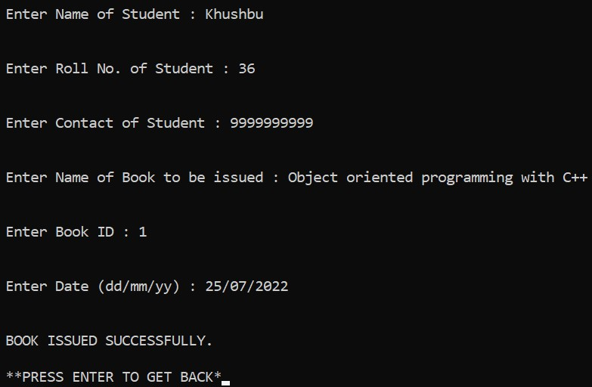
void issue_book()
This function is created to issue a particular book to a student whose data is taken as input from the librarian using the input() function declared in class student.
This input function prompts the user to enter their name, roll no, contact no, book, book id and date.
The data of student is stored in a file “Studentdata.txt” and details of required book are temporarily stored in “Temporary.txt”.
If id of the entered book match that of any book in booklist. That book is issued to the student.
If it doesn’t match, then the message, “BOOK NOT FOUND” is printed on the console.

Slide 13
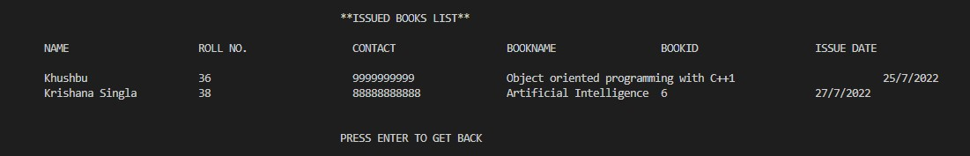
void view_issued_books()
This function is created to show the list of issued books and students to whom those books are issued.
It just opens the file “Studentdata.txt” in read mode and prints the data of student and the corresponding issued book on the screen.

Slide 14
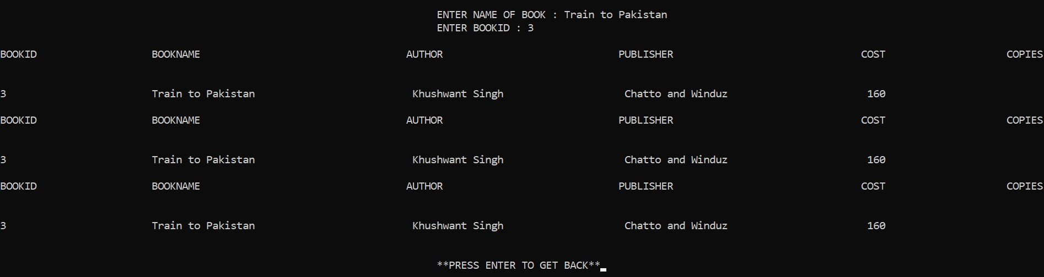
void search_book()
This function is created to search a book in the database of library and to know how many copies of the book does the library have.
First, details of the book like book name and book id are entered by the librarian.
Then, the file, “Bookdata.txt” is opened and it is checked if the name of entered book match any book in the database.
If it matches, then details of he book are printed.
Otherwise, the message, “BOOK NOT FOUND” is printed on the screen.

Slide 15
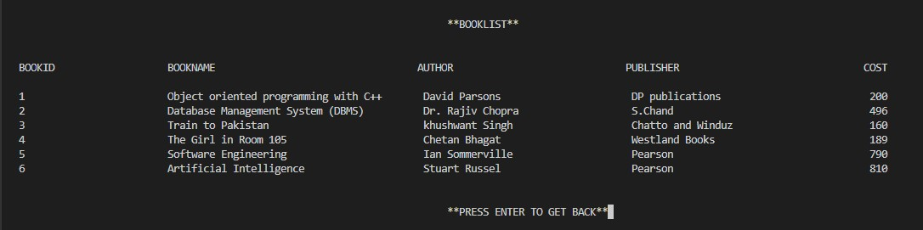
void view_booklist()
This function is created to view the list of books present in the library.
It just opens the file, “Bookdata.txt” in read mode, prints its data on the screen and closes the file.

Slide 16
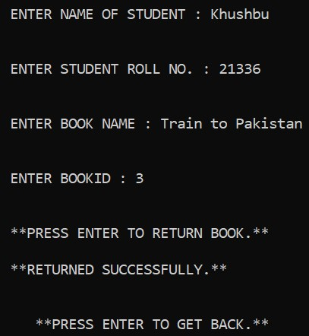
void return_book()
This function is created to return the book to the library.
In this the data of student and issued book is entered by the librarian.
If the details match with the issued books details, then the book is returned and the details are removed from issued books.
If not, then the message, “INVALID ISSUE DETAILS” is printed on the screen.

Slide 17
Submitted By :-
Khushbu CO21336
Krishana Singla CO21338
Project Link :-
https://github.com/Krishana-Singla/Library-Management-System

Slide 18
Thanks

